Slide 1
Computational Thinking

Slide 2
What is Computational Thinking?
A method of thinking that lets us take a complex problem, break it down into easy-to-manage parts, and develop possible solutions
But Computational Thinking is not coding!
It is the foundation of coding, but can be used for any complex problem

Slide 3
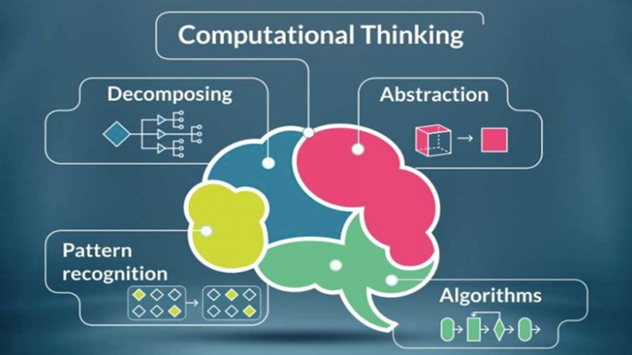
The Four Parts of Computational Thinking

Slide 4
Decomposition
Decomposition is the breaking down of a complex problem or system into smaller, more manageable parts
Example: Planning a Vacation
Planning a vacation is an overarching challenge which can be broken into many smaller parts
I.E. arranging the travel, booking the hotel room, deciding on what sights to see

Slide 5
Pattern Recognition
Pattern Recognition is looking for similarities among and within problems
A pattern may be the types of information collected. Or it may be a similarity between this and other problems. Or it may be similar steps taken to solve each part of a problem.
Example: Buying Groceries
Say I have 10 items on my grocery list
Instead of going to the grocery store, picking out an item, paying for it, then driving it home 10 times, I drive there once, pick out all 10 items, then pay and return home once.

Slide 6
Abstraction
Abstraction is the act of focusing on the important information only.
With abstraction we eliminate and ignore irrelevant data
Example: counting trees
Tasked with counting trees in a field, we simply need to know that a tree is a tall wooden object with branches and leaves
We don’t need to specifically know what types of trees are out there, or how many branches or leaves are on each tree

Slide 7
Algorithms
An algorithm is the logical step-by-step process for solving a problem
Combining all the details of Decomposition, Abstraction, and Pattern Recognition, we can then develop algorithms to solve our problems.
Algorithms are normally presented as a flowchart or as pseudocode

Slide 8
Pseudocode
Pseudocode is a plain language descriptions of the steps a program needs to take.
Writing pseudocode is faster and easier than writing full code.
When programming, it is best to write out your program entirely in pseudocode first. Then go back and fill it in with real code.

Slide 9
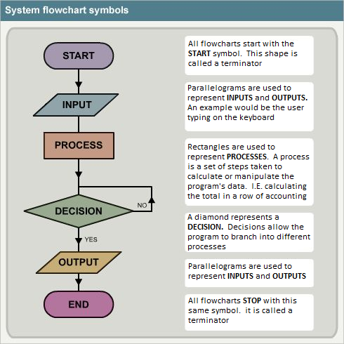
Flowcharts
Flowcharts are a visual representation of the steps needed to accomplish a task
Programming flowcharts use the following symbols

Slide 10
Practical Example
Getting Clothes for a Date

